Slide 1


FEATURE ENGINEERING
Crafting Powerful Features
Data Preparation Mastery
🔧 Data Cleaning | ✨ Feature Creation
Missing Values, Scaling, Encoding, Selection, Transformation, Outliers
LEARN
APPLY
MASTER

Slide 2
Overview of 6 Core Techniques
Data Cleaning & Missing Values
Handle NaN, imputation strategies
Feature Scaling & Normalization
Standardize, normalize ranges
Categorical Encoding
One-hot, label, ordinal encoding
Feature Selection
Choose best features, reduce dimensions
Feature Transformation
Log, polynomial, interactions, binning
Outliers & Imbalanced Data
Handle extremes, class imbalance

Slide 3
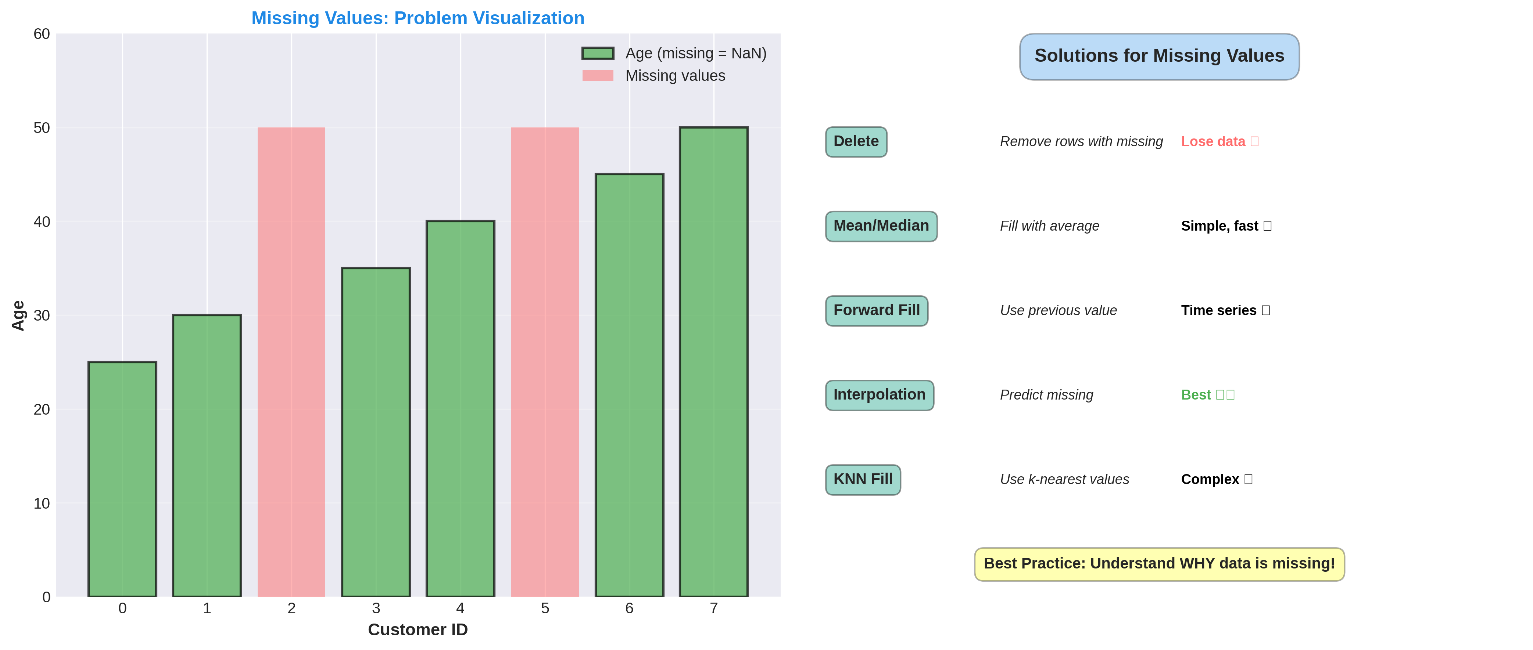
1. Missing Values - Handling Strategies

Slide 4
1. Missing Values - Methods
Deletion Methods
Delete rows: Simple but
loses data
Delete columns: Only if
>50% missing
Pairwise deletion: Use
available data only
Imputation Methods
Mean/Median: Quick, simple
Forward Fill: Time series
Interpolation: More accurate
KNN: Use neighbors' values
Prediction: ML model

Slide 5
1. Missing Values - Summary
Problem: NaN values prevent model training
Impact: Can drop model accuracy by 20-30%
Solution: Delete (simple) or Impute (preserve data)
Best Practice: Use median/interpolation, not mean
Tip: Check if missingness is random
Code: from sklearn.impute import SimpleImputer

Slide 6
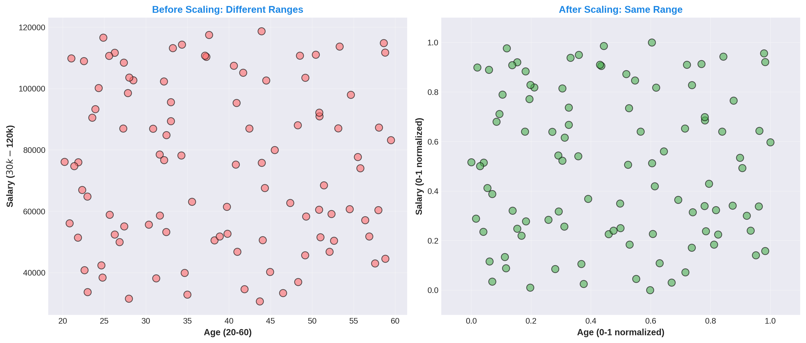
2. Scaling - Before & After Visualization

Slide 7
2. Scaling - When Not to Use
DON'T Scale If Using:
Decision Trees/Forests
(They don't care about scale)
Interpretable coefficients
(Scaling changes meaning)
Sparse data
(Scaling makes dense)
DO Scale If Using:
KNN, K-Means clustering
SVM, Neural Networks
Ridge, Lasso regression
PCA, t-SNE
Distance-based methods

Slide 8
2. Scaling - Summary
Problem: Features have different ranges
Impact: Distance algorithms affected, 3-15% accuracy loss
Solution: Min-Max (0-1) or Standardization (mean=0)
Default: StandardScaler (most algorithms)
Important: Fit on training, apply to test data!
Code: from sklearn.preprocessing import StandardScaler

Slide 9
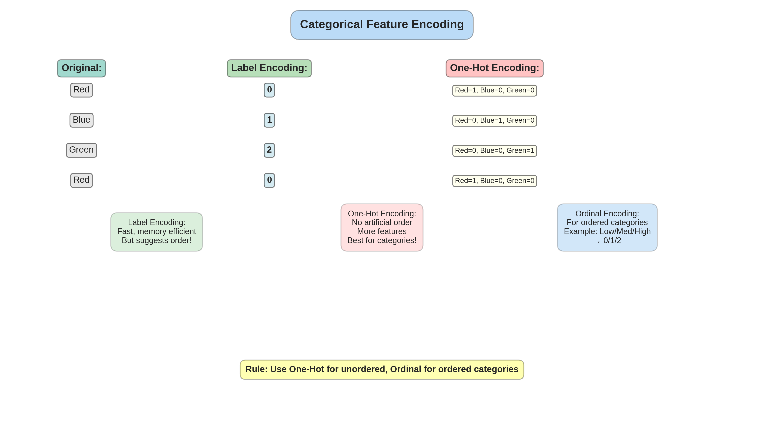
3. Categorical Encoding - Methods Comparison

Slide 10
3. Encoding - Decision Guide
Use Label Encoding
Binary feature (2 categories)
Example: Yes/No, M/F
Ordinal categories
Example: Low/Med/High
Tree-based models
(XGBoost, Random Forest)
Use One-Hot Encoding
Nominal categories (no order)
Example: Red/Blue/Green
Many categories not possible
Max 10-20 categories
Linear/Distance models
KNN, SVM, Neural Networks

Slide 11
3. Encoding - Summary
Problem: Models can't process text like 'Red', 'Blue'
Label Encoding: Single column: 0, 1, 2 (creates order)
One-Hot Encoding: Multiple columns: creates binary flags
Ordinal Encoding: For ordered categories: Low=0, High=2
Best Practice: Use One-Hot for unordered categories
Code: from sklearn.preprocessing import OneHotEncoder

Slide 12
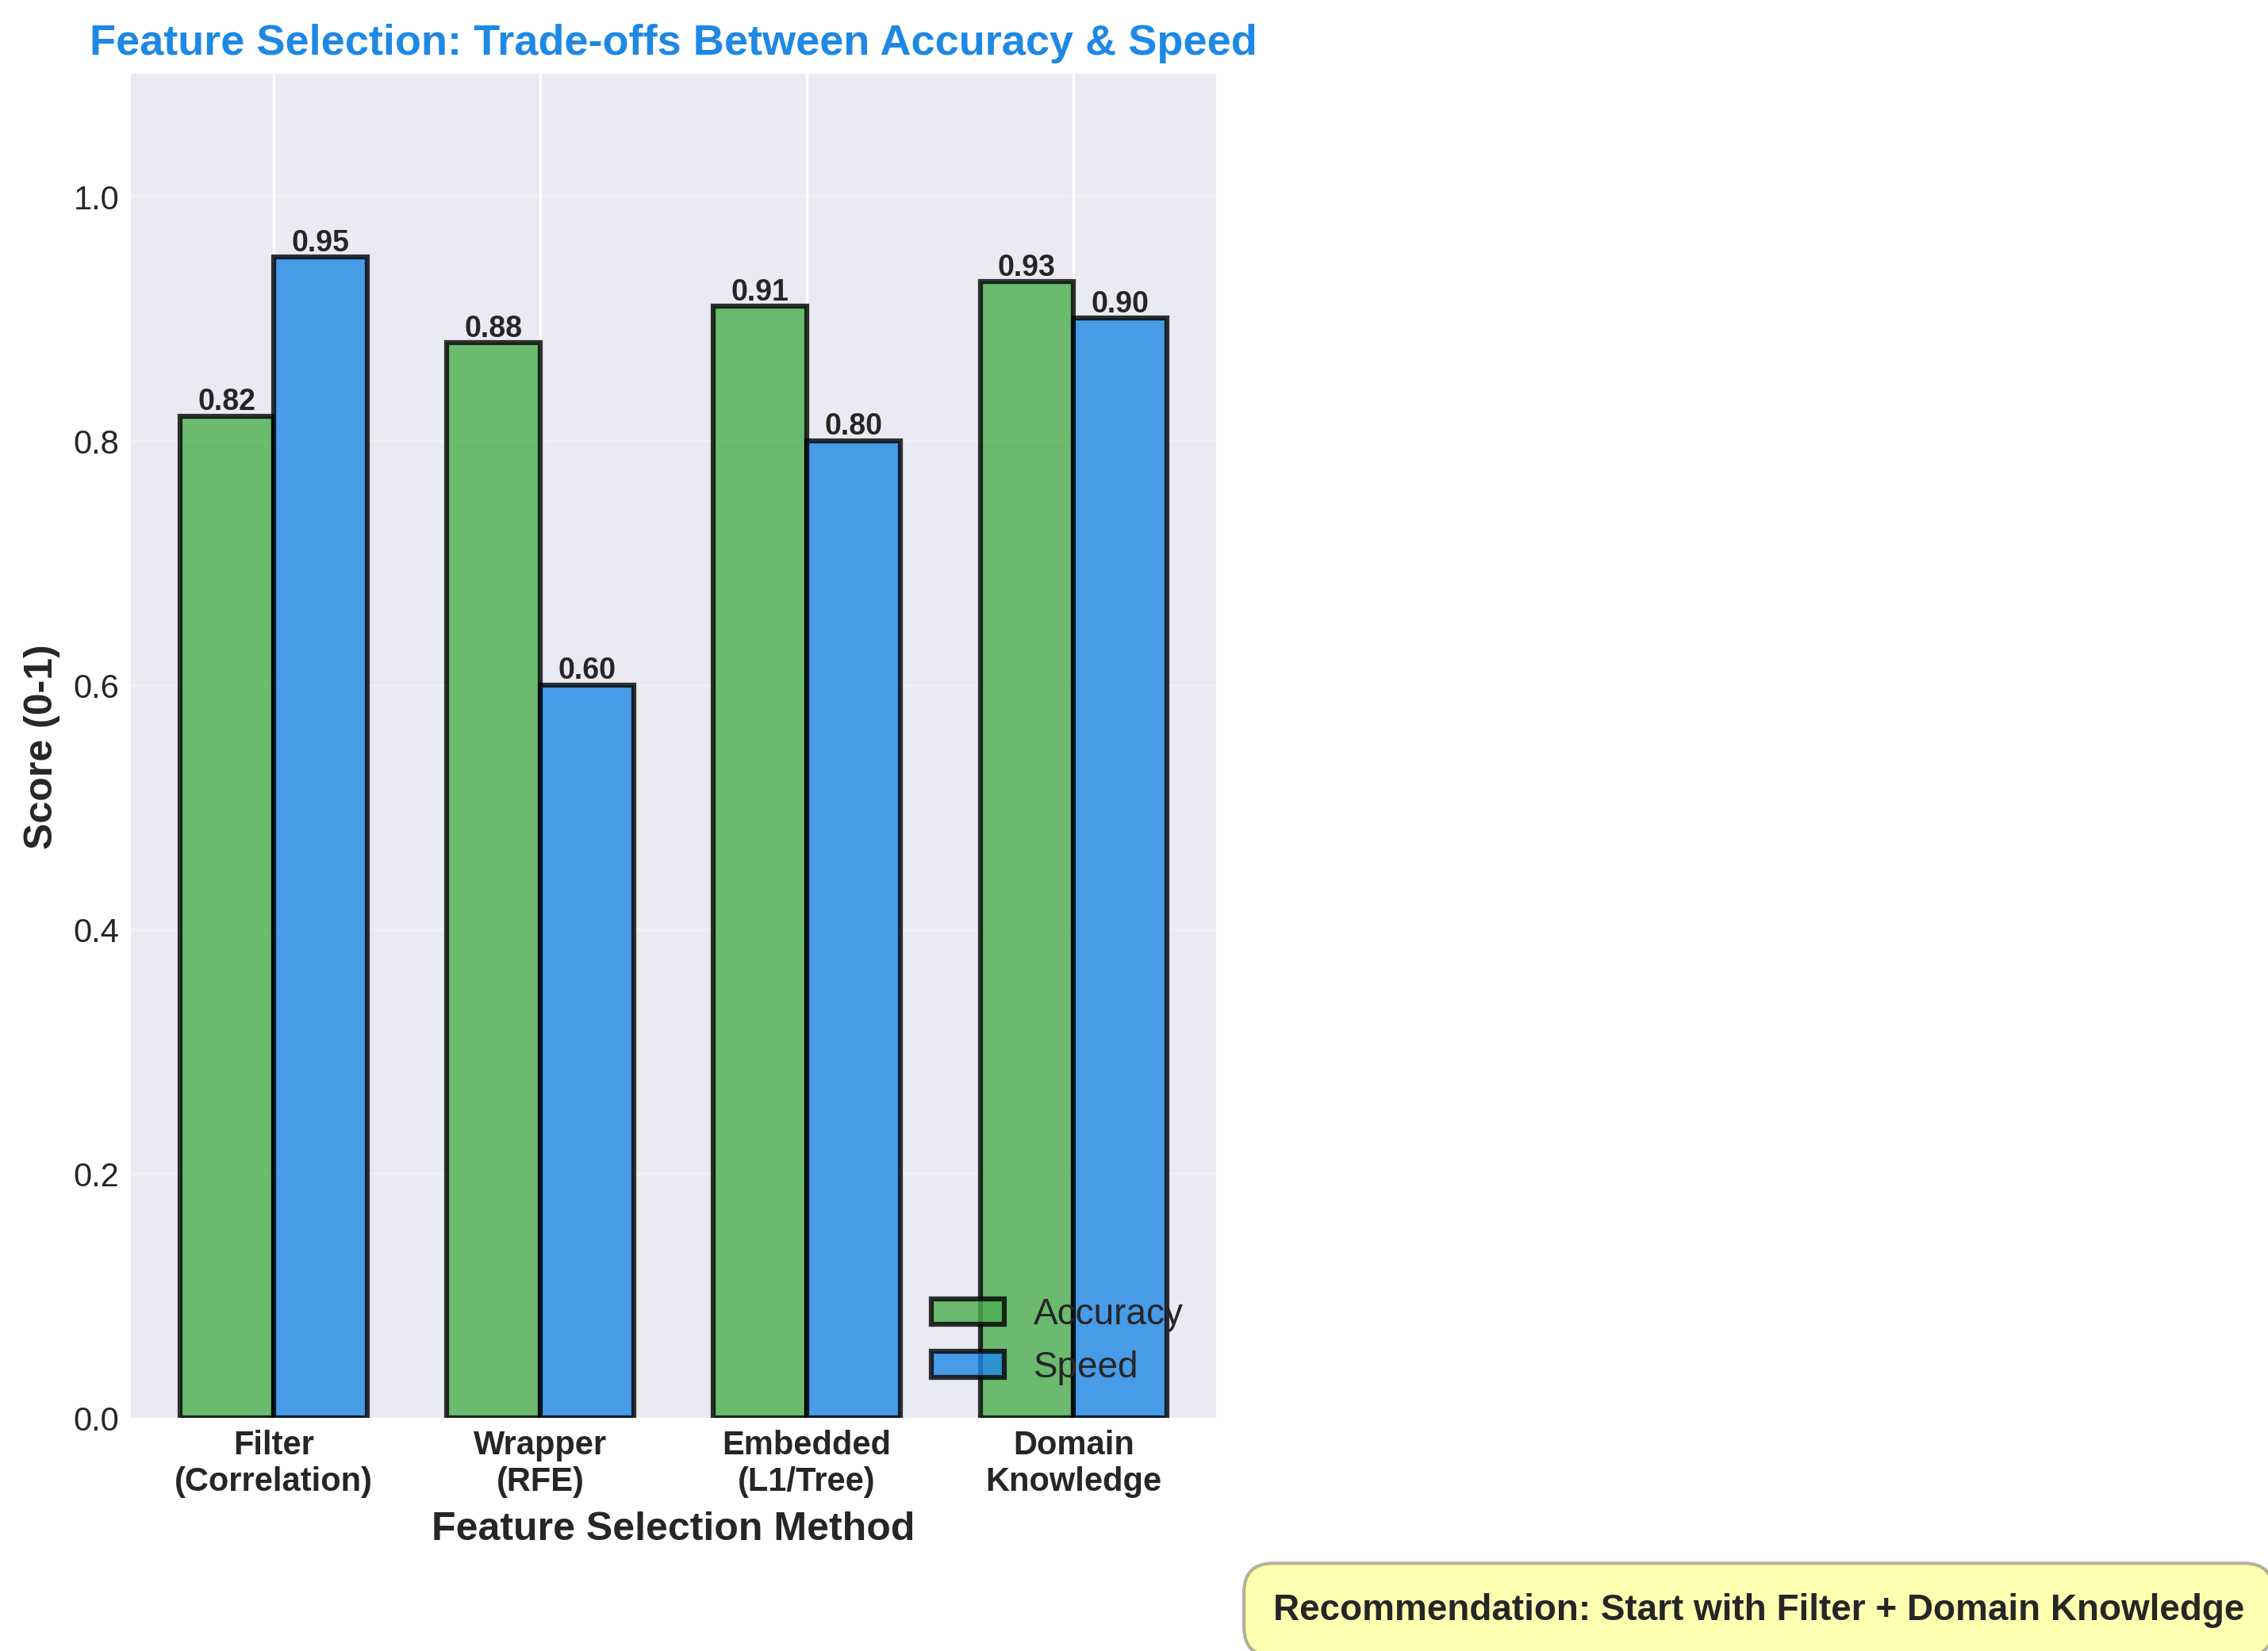
4. Feature Selection - Methods Comparison

Slide 13
4. Feature Selection - Best Practices
Start With
Domain knowledge first
(Always most important!)
Correlation analysis
Remove highly correlated
Tree importance
(XGBoost, Random Forest)
Then Try
Filter methods
(Fast, good baseline)
Embedded methods
(During training)
Wrapper if needed
(Slower but thorough)

Slide 14
4. Feature Selection - Summary
Problem: Too many features cause overfitting
Filter: Correlation, mutual info (fast)
Wrapper: RFE, recursive elimination (slow, best)
Embedded: L1/Lasso, tree importance (balanced)
Benefit: 5-10× faster models, better accuracy!
Code: from sklearn.feature_selection import RFE

Slide 15
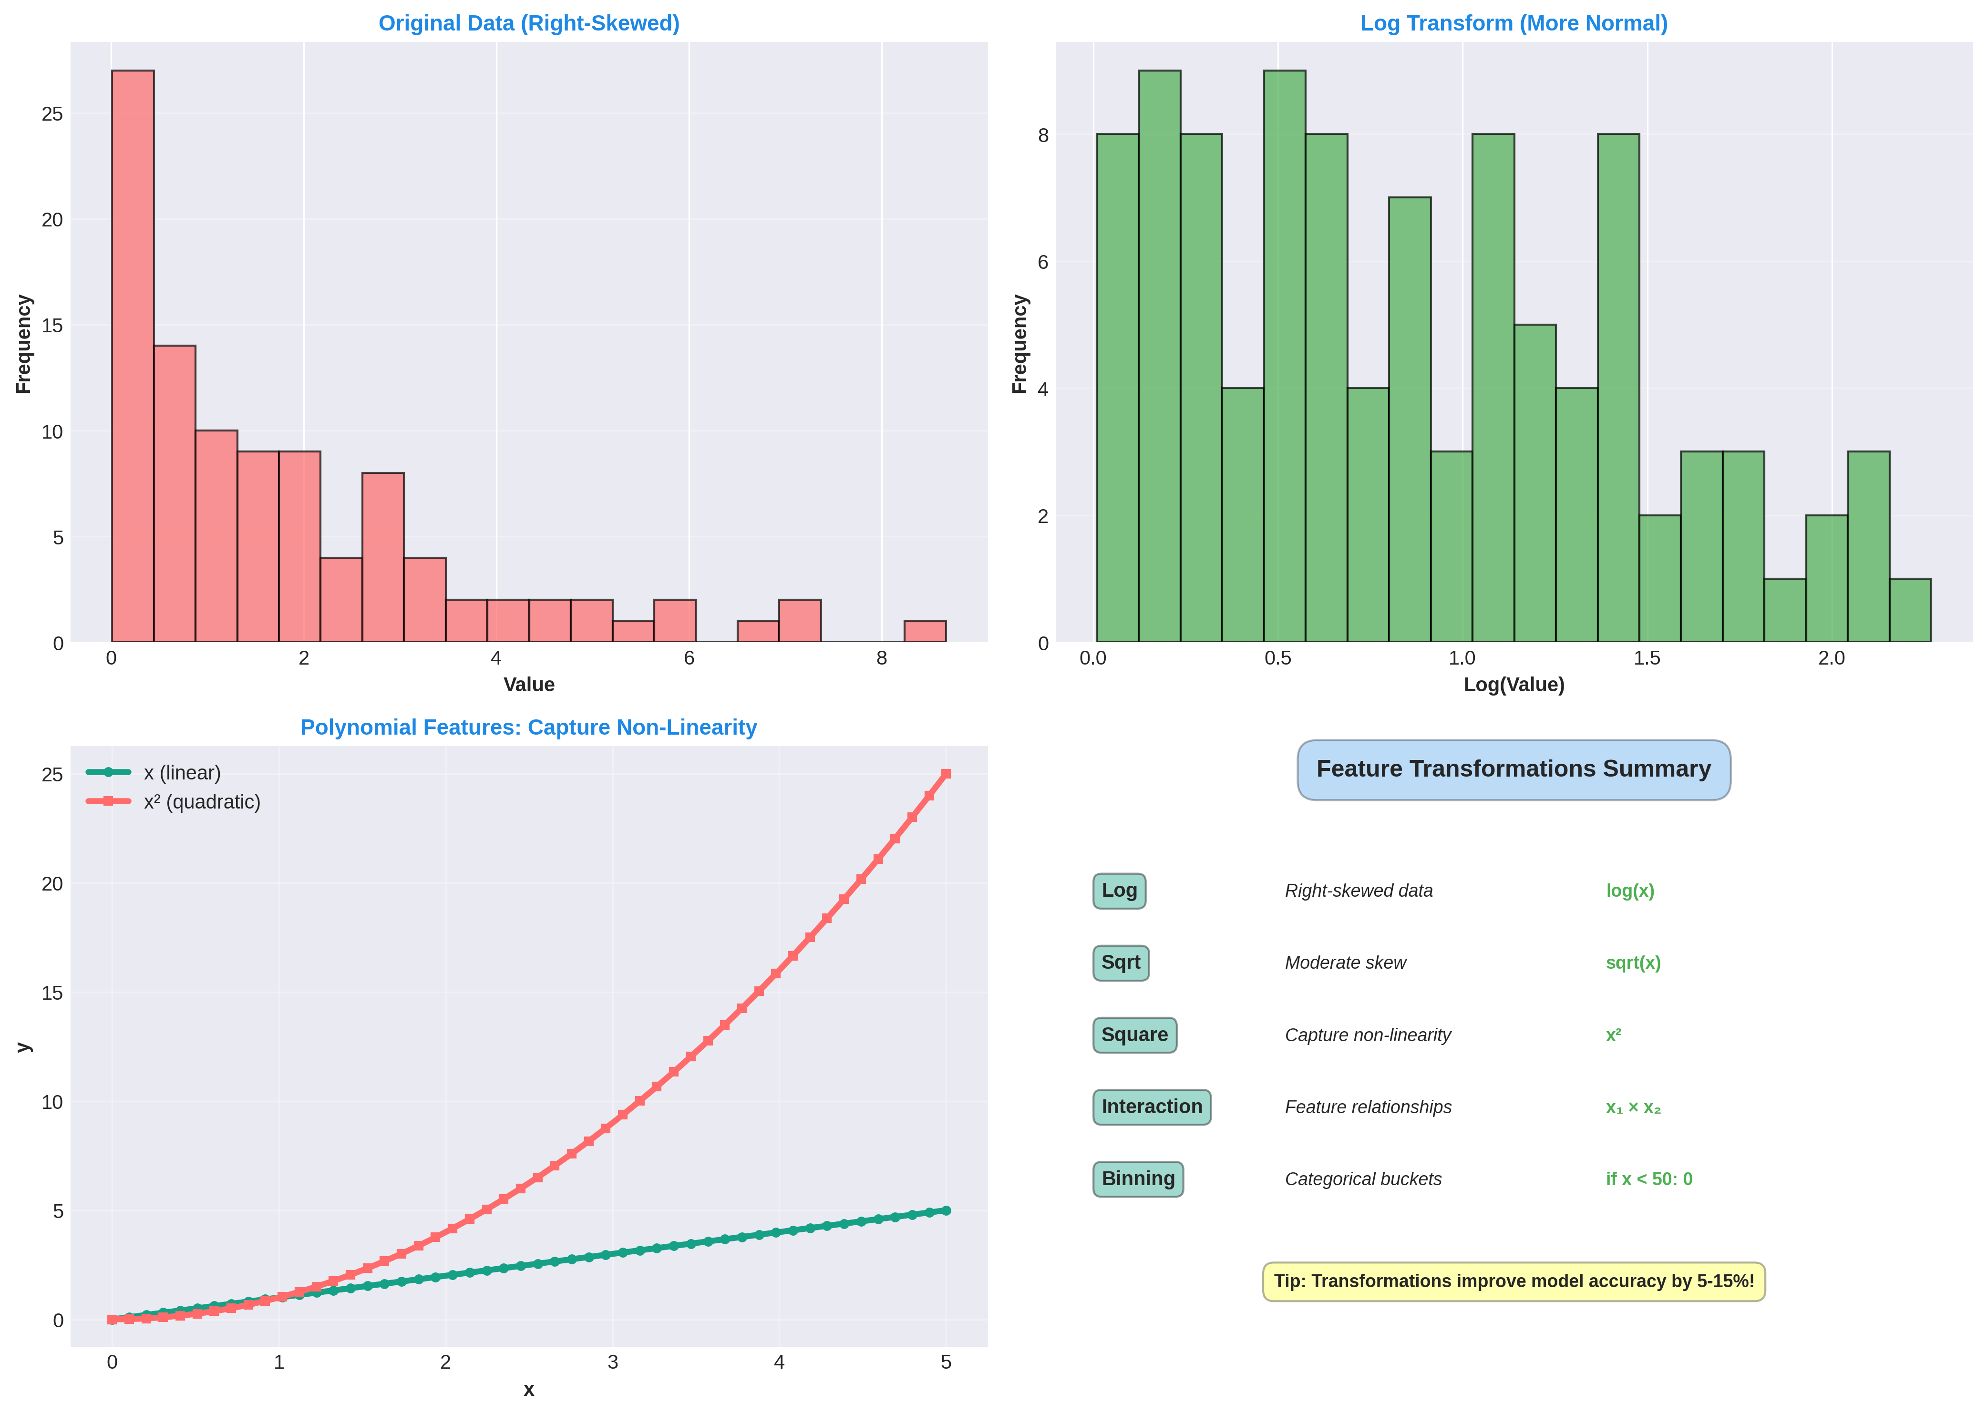
5. Transformation - Log, Polynomial, Interaction

Slide 16
5. Transformation - Summary
Log Transform: Right-skewed data, exponential
Polynomial: Non-linear relationships (x^2, sqrt)
Interaction: Feature combinations (x1 * x2)
Binning: Convert continuous to categorical
Impact: Usually 5-15% accuracy improvement
Code: np.log1p(X) or PolynomialFeatures(2)

Slide 17
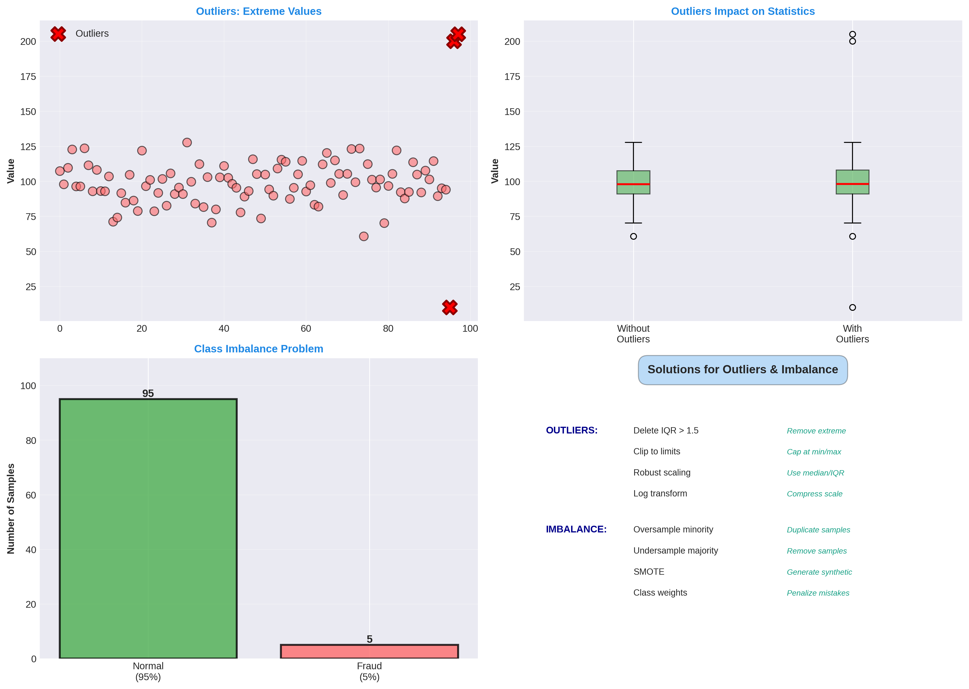
6. Outliers & Imbalance - Detection & Solutions

Slide 18
6. Handling Strategies
Outlier Handling
IQR method: Remove Q3+1.5*IQR
Z-score: Remove |z| > 3
Clipping: Cap at min/max
Log transform: Compress range
Imbalance Handling
Oversampling: Duplicate minority
Undersampling: Remove majority
SMOTE: Create synthetic
Class weights: Penalize

Slide 19
6. Outliers & Imbalance - Summary
Outliers: Extreme values cause poor predictions
Detection: IQR method (Q1-1.5*IQR, Q3+1.5*IQR)
Handling: Remove, clip, or transform (log)
Imbalance: Unequal classes: model biased
Solution: SMOTE (best), oversampling, class weights
Code: from imblearn.over_sampling import SMOTE

Slide 20
Feature Engineering Workflow
Complete Pipeline
1. DATA CLEANING: Handle missing values
→ Delete rows (>30% missing) or Impute (mean/median)
2. OUTLIER HANDLING: Remove/clip extreme values
→ IQR method or Z-score
3. ENCODING: Convert categories to numbers
→ One-Hot for unordered, Ordinal for ordered
4. SCALING: Normalize all features
→ StandardScaler (default) or MinMaxScaler
5. TRANSFORMATION: Create new meaningful features
→ Log (skewed), Polynomial (non-linear), Interaction
6. FEATURE SELECTION: Keep only important features
→ Correlation, RFE, or tree importance
7. HANDLE IMBALANCE: Balance class distribution
→ SMOTE or class weights
RESULT: Clean, normalized, balanced, engineered features!
Expect: 10-30% accuracy improvement

Slide 21
Real-World Impact: Before & After
Kaggle Competitions: Before: 75% accuracy | After: 89% (engineering) | +14%!
Fraud Detection: Before: 82% | After: 91% | +9%
Customer Churn: Before: 80% | After: 87% | +7%
Loan Default: Before: 78% | After: 85% | +7%
Disease Diagnosis: Before: 85% | After: 93% | +8%
Feature engineering is often 50% of ML work and 50% of accuracy gains!

